Slide 1

ZAS Robotic Products
Navigational Robotic Series
Robot Car-3 (Advanced Autonomy)
Wheel Encoder Counts & Odometry Fundamentals

Slide 2
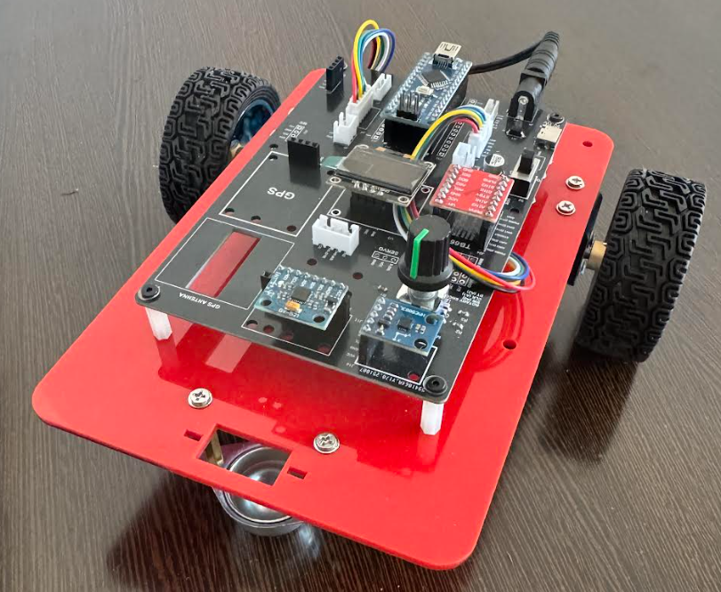
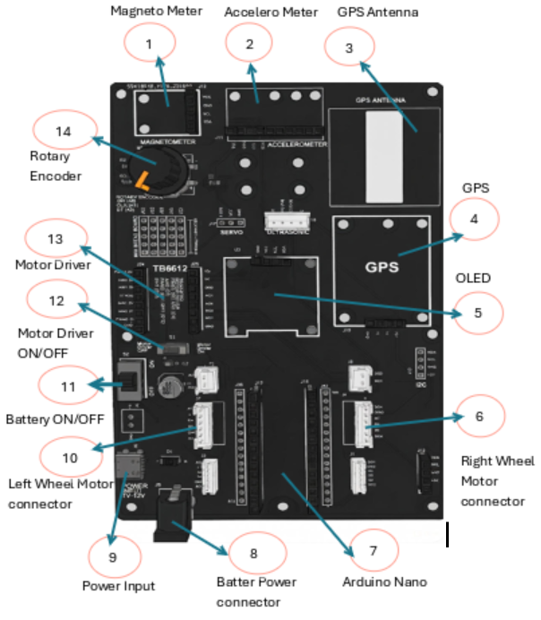
Wheel Encoder Counts & Odometry
Robot Car-3 - Assembled view and Creative Board component layout

Slide 3
Wheel Encoder Counts & Odometry
Objective of the Experiment
Objective
To measure wheel rotation using quadrature encoders
To determine direction of motion using encoder phase signals
To implement interrupt-based counting for accurate pulse detection
To visualize encoder counts in real time on OLED
This experiment establishes the core sensing layer for autonomous navigation.
Pre-requisite:
Mandatory to complete the first lesson car-3 Basic Movements

Slide 4
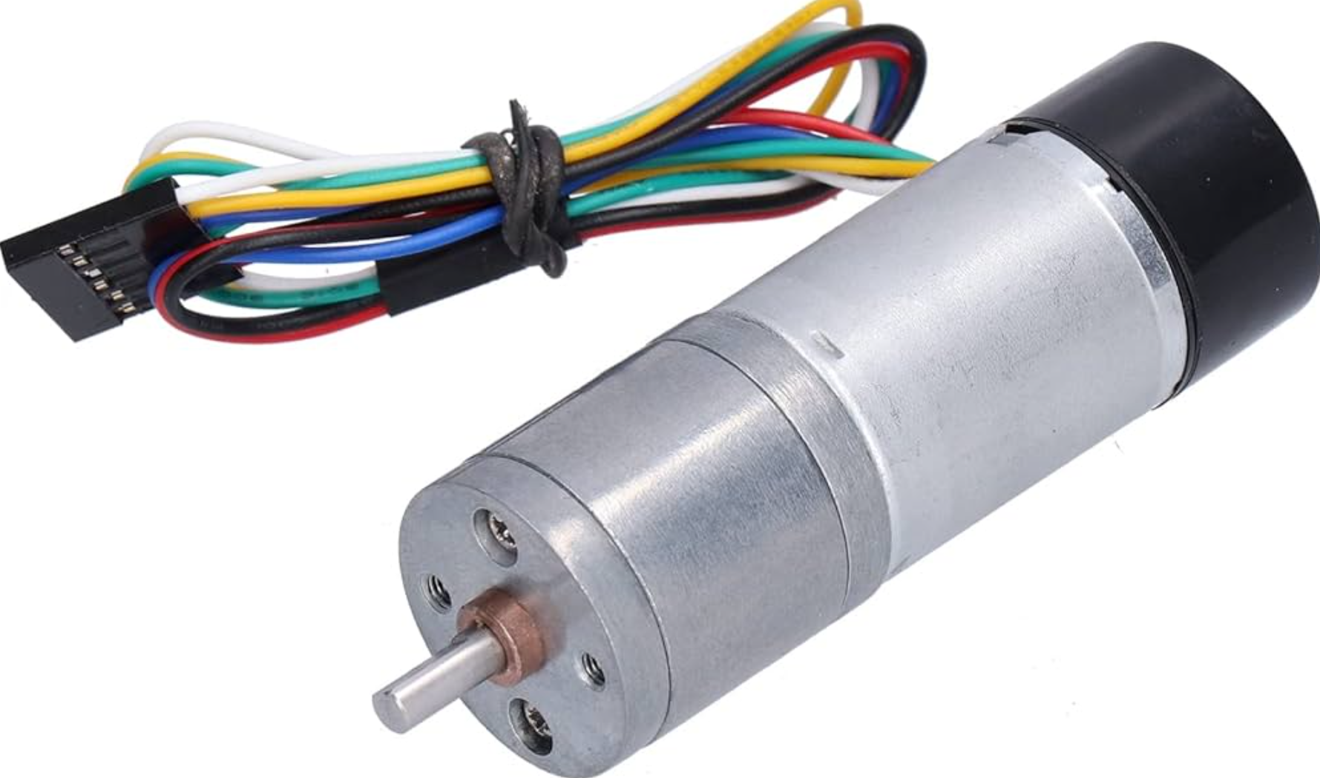
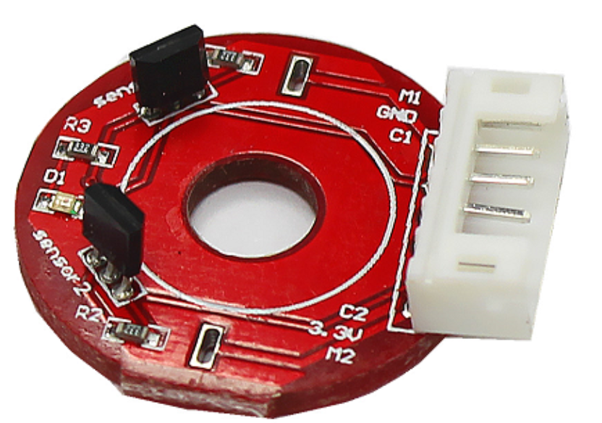
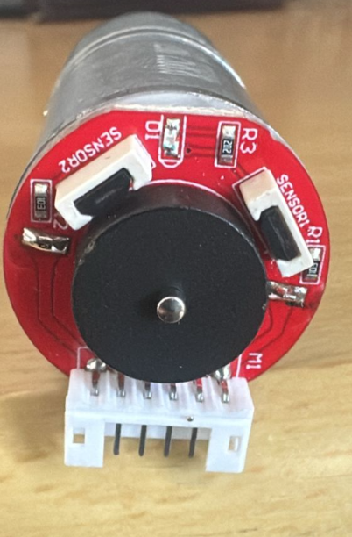
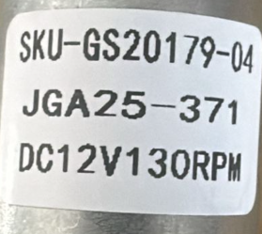
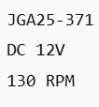
Wheel Encoder Counts & Odometry
JGA25-371 Motor – Pin Groups, Encoder Details & Comparison
Pin Group | Pin / Wire | Function | Connected To
Motor (Power) | M+ | Motor terminal (+) | TB6612 AO1 / BO1
 | M− | Motor terminal (−) | TB6612 AO2 / BO2
Encoder (Sensor) | VCC | Encoder power supply | Arduino 5V
 | GND | Encoder ground | Arduino GND
 | ENCA_L | Left wheel pulse output | Arduino Pin 2 (Interrupt)
 | ENCB_L | Left wheel direction | Arduino Pin 4
 | ENCA_R | Right wheel pulse output | Arduino Pin 3 (Interrupt)
 | ENCB_R | Right wheel direction | Arduino Pin 5
Motor & connector
Encoder
Motor vs Encoder
Aspect | Motor / Actuator (via TB6612) | Encoder / Sensor
Function | Makes wheel rotate | Measures wheel motion
Power/Current | High current | Low-power digital signals
Role | Controls direction & speed | Provides speed, distance & direction
Type | Actuator | Sensor
Motor & encode mounted
Motor Specs

Slide 5
Wheel Encoder Counts & Odometry
Why Wheel Encoders Are Important
Why Encoders Matter in Robotics
Motors do not guarantee motion
Wheels may:
Slip
Stall
Rotate unevenly
Encoders provide actual movement feedback
Encoders answer:
“How much did the robot really move?”

Slide 6
Wheel Encoder Counts & Odometry
Hardware Overview
Hardware Used
DC Motors with Quadrature Encoders
Encoder Signals
ENCA → Pulse count
ENCB → Direction detection
Arduino Nano
External interrupts on pins D2, D3
OLED Display
Live visualization of encoder counts

Slide 7
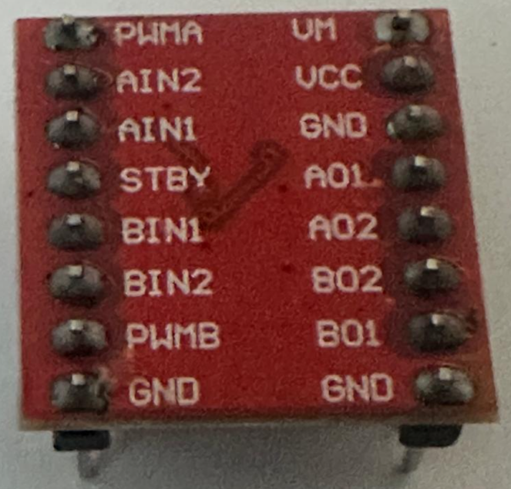
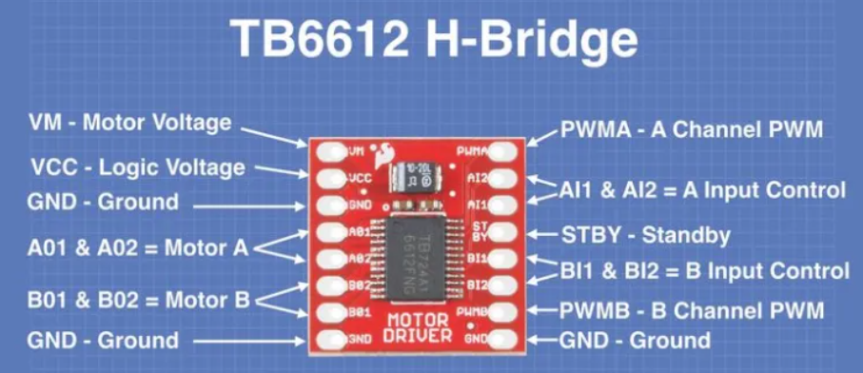
Wheel Encoder Counts & Odometry
Hardware Architecture
Pin Name | Function | Description | Connected To (in Our Robot)
PWMA(PWM_L) | Speed Control (A) | PWM input for Motor A speed (0-255) | Arduino Pin 6
AIN1 (IN1_L) | Direction (A) Bit 1 | Motor A direction control | Arduino Pin 7
AIN2 (IN2_L) | Direction (A) Bit 2 | Motor A direction control | Arduino Pin 8
PWMB(PWM_R) | Speed Control (B) | PWM input for Motor B speed (0-255) | Arduino Pin 11
BIN1 (IN1_R) | Direction (B) Bit 1 | Motor B direction control | Arduino Pin 12
BIN2(IN2_R) | Direction (B) Bit 2 | Motor B direction control | Arduino Pin 10
STBY | Standby | Enable/Disable driver (HIGH = enabled) | Usually tied to VCC
VM | Motor Power | 7-12V for motors | External battery
VCC | Logic Power | 5V from Arduino | Arduino 5V
GND | Ground | Common ground | Arduino GND
AO1/AO2 | Motor A Outputs | Connect to Motor A terminals | Left Motor
BO1/BO2 | Motor B Outputs | Connect to Motor B terminals | Right Motor
TB6612 Pin configuration With Arduino
Back View of Driver

Slide 8
Wheel Encoder Counts & Odometry
Key Concepts Introduced
Core Concepts
Encoder pulses
Interrupt Service Routines (ISR)
Direction detection (A/B phase)
Atomic data access
Odometry fundamentals
This experiment links electronics, embedded programming, and robot kinematics.

Slide 9
Wheel Encoder Counts & Odometry
Quadrature Encoder Principle
Quadrature Encoding
Two signals: Channel A & Channel B
Phase difference determines direction
A | B
Rising A, B=HIGH | Forward
Rising A, B=LOW | Reverse
This allows direction detection without extra sensors.

Slide 10
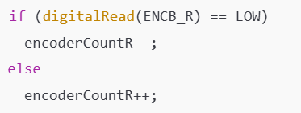
Wheel Encoder Counts & Odometry
Encoder Direction Logic (Code Concept)
Direction Detection Logic
Channel A triggers interrupt
Channel B determines sign (+ / −)
Produces signed encoder counts

Slide 11
Wheel Encoder Counts & Odometry
Interrupt-Based Measurement
Why Interrupts Are Used
Encoder pulses occur asynchronously
Polling may:
Miss pulses
Reduce accuracy
Interrupts ensure:
No missed counts
Accurate high-resolution measurement
Real-time responsiveness

Slide 12
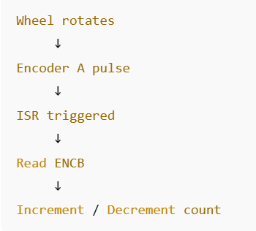
Wheel Encoder Counts & Odometry
Interrupt Flow
This happens independent of loop execution speed.

Slide 13
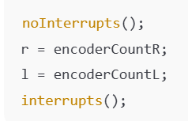
Wheel Encoder Counts & Odometry
Atomic Data Handling
Why Atomic Reading Is Required
Encoder counts are updated inside ISRs.
Prevents:
Partial reads
Data corruption
Inconsistent display values

Slide 14
Wheel Encoder Counts & Odometry
OLED Display Strategy
Display Design
Clear title for context
Large numeric values for readability
Separate Left and Right wheel data
This improves:
Debugging
Understanding motion symmetry
Visual validation during testing

Slide 15
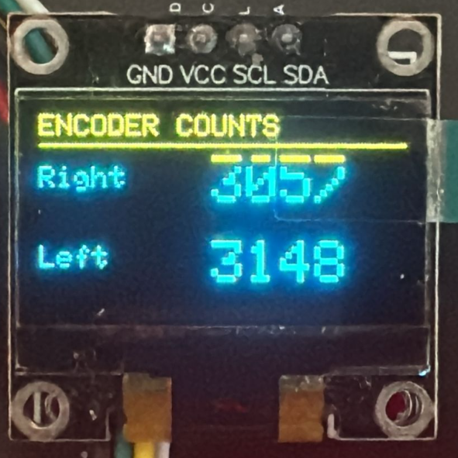
Wheel Encoder Counts & Odometry
OLED Output Interpretation
OLED Output Meaning
OLED Field | Meaning
Right | Total encoder pulses from right wheel
Left | Total encoder pulses from left wheel
Increasing value | Wheel rotating forward
Decreasing value | Wheel rotating backward
Unequal counts | Turning / drift

Slide 16
Wheel Encoder Counts & Odometry
What the Encoder Counts Represent
Physical Meaning
Encoder Count ∝ Wheel Rotation ∝ Distance Traveled
With known parameters:
Pulses per revolution
Wheel diameter
Counts can be converted to:
Distance (cm / m)
Speed
Robot displacement

Slide 17
Wheel Encoder Counts & Odometry
Introduction to Odometry
Odometry
Odometry is the estimation of robot position using wheel motion.
Based on:
Left wheel distance
Right wheel distance
Wheel base
Encoders are the primary sensor for odometry.

Slide 18
Wheel Encoder Counts & Odometry
Limitations of Encoder-Only Odometry
Limitations
Wheel slip
Uneven surfaces
Accumulated error (drift)
Therefore, encoders are later combined with:
Gyroscope
Compass
GPS

Slide 19
Wheel Encoder Counts & Odometry
Relation to Other Sensors (Context Slide)
Sensor Roles in Navigation
Sensor | Role
Encoder | Distance & speed
Gyroscope | Rotation rate
Accelerometer | Linear motion
Magnetometer | Absolute heading
GPS | Global position
Sensor Fusion | Error reduction

Slide 20
Wheel Encoder Counts & Odometry
Applications in Robotics
Where This Is Used
Differential drive control
Line following
Distance-based movement
Closed-loop speed control
SLAM (advanced)
Autonomous navigation
Encoders are present in almost every mobile robot.

Slide 21
Wheel Encoder Counts & Odometry
Learning Outcome (Engineering Perspective)
Learning Outcome
Understanding real-world motion sensing
Implementing interrupt-driven systems
Interpreting signed sensor data
Bridging theory and physical motion
Preparing for odometry and sensor fusion
This experiment forms a core prerequisite for autonomy.
Conclusion
Wheel encoders provide the most fundamental feedback for mobile robots. This experiment establishes the measurement layer required before implementing navigation, control, and autonomy algorithms.

Slide 22
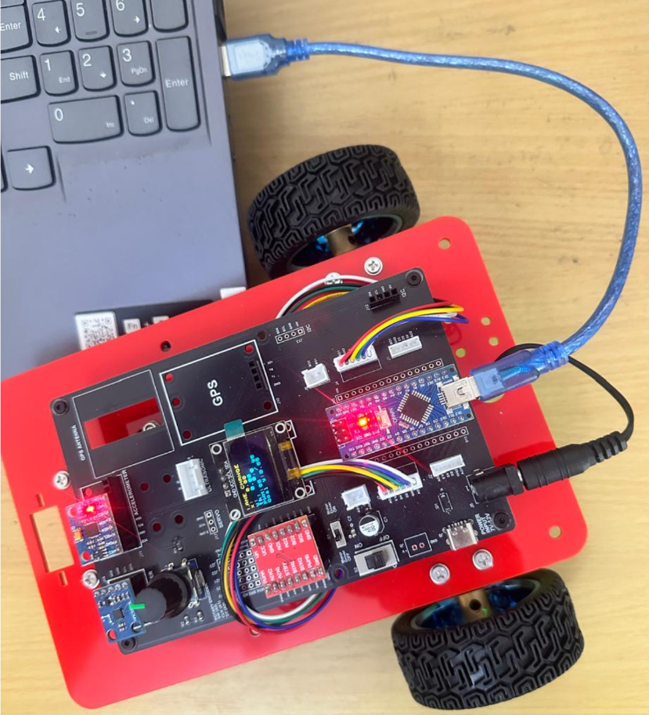
Wheel Encoder Counts & Odometry
Critical Programming Setup
MANDATORY Switch Settings Before Uploading Code
Before connecting USB and uploading program:
“Motor Driver ON/OFF” Switch
⚠️ MUST BE SET TO: OFF
Why?
Prevents motors from running during code upload
Avoids car moving unexpectedly on desk
Protects USB connection from power surges

Slide 23
Wheel Encoder Counts & Odometry
During Programming (Code Upload):
Step 1: Connect USB cable to computer
Step 2: Set Switch “Motor Driver ON/OFF” → OFF
Step 3: Set Switch “Battery ON/OFF ” → OFF ->for batter power
Step 4: Upload your the respective program
Step 5: Wait for "Upload Complete" message
Step 6: Disconnect USB cable
Before Testing (Running the Robot):
Step 1: Place robot on the ground. No obstacle as this test for basic movements
Step 2: Set Switch “Motor Driver ON/OFF” ->ON ( motor driver ON)
Step 3: Set Switch “Battery ON/OFF” → ON -> for batter power
Step 4: Monitor the Robot car-3 Movements & OLED , Monitior the functionality according to the program
https://github.com/info-zas/zas-robotics-car-3-encoders-imu-gps/tree/main/01_FoundationProjects/02_Car-3_Encoder_Motors_Ticks
Lesson Code – GitHub URL:

Slide 24
Q&A
Invite Questions: Encourage the audience to ask questions for further clarification or discussion.

